Slide 1
Performance Engineering at Fitbit
02/21/2019

Slide 2
Agenda
Performance as a global issue for companies
Ways of mitigation performance issues
How we are struggling with performance
Tooling, Frameworks, Guides
Goal: Tell everyone how Fitbit deals with performance as an engineering practise.

Slide 3
Is Performance a problem for you?
Small startups don’t have a scale that requires factoring performance
Startups have a lot of other things to do to stay competitive and growing
Big companies experience a lot of Performance issues as the systems scale and architecture chosen hits its limits

Slide 4
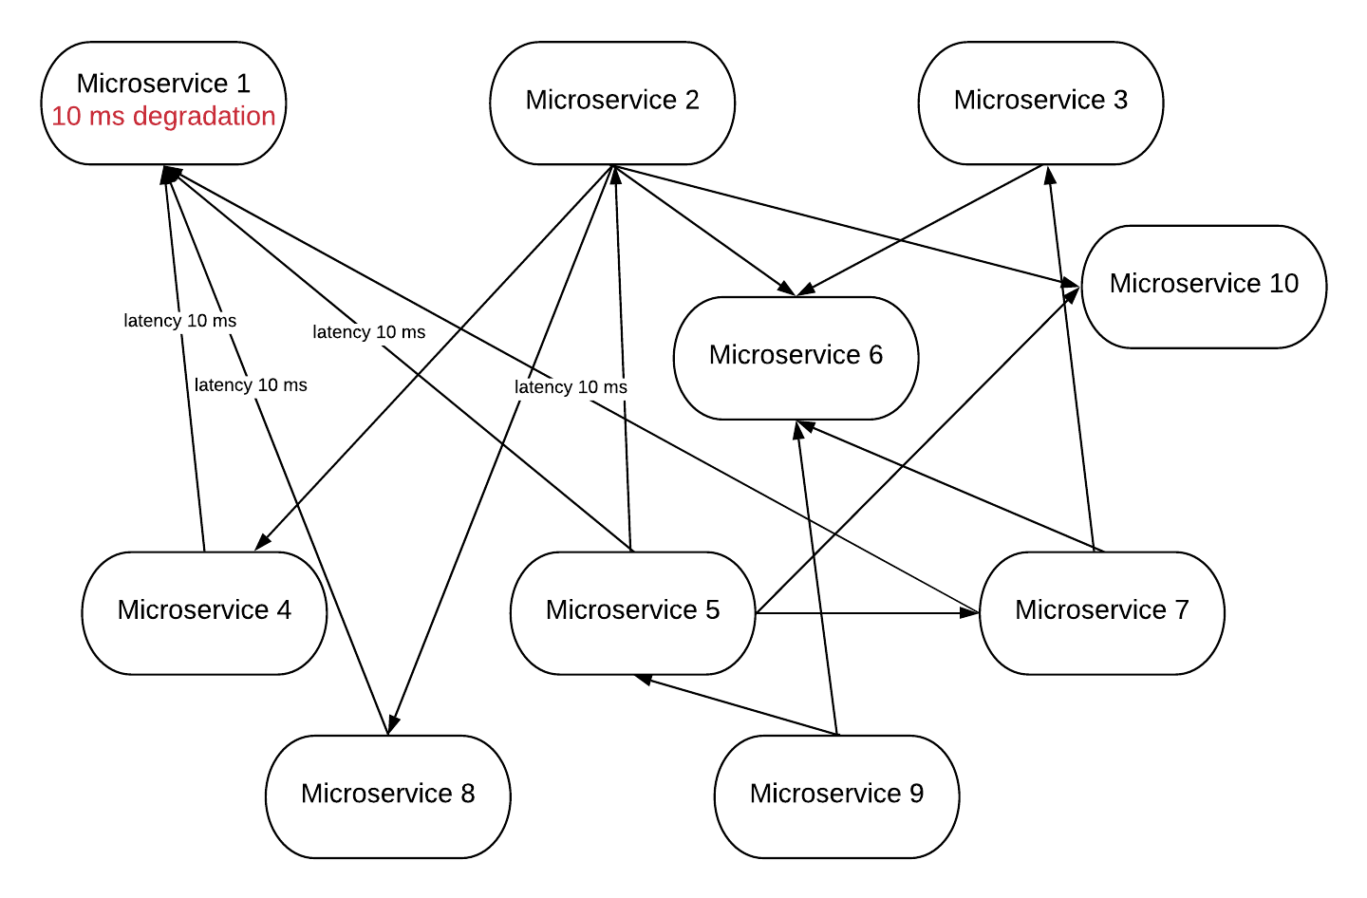
Example of a Cascading Performance Issue

Slide 5
Fitbit: Strength in Numbers
Hundreds of microservices are running in production on dozens of mesos workers
Large scale of mysql & cassandra shards
Large Google Cloud footprint and growing
Over 25 millions of active users (as of Jan 2018)
Lots of teams utilizing the same shared frameworks

Slide 6
Why companies are experiencing issues with performance ?
There is no sustainable process of performance testing
Business doesn’t think about this until serious down time or outage happens
Team often don’t know how to do this even they know that this is important
Performance decreases silently and often do not trigger alerts

Slide 7
How other companies are mitigating performance issues
Over building - more hardware to spread things out
Tooling to help teams understand if the release is good
Dashboards showing key performance metrics increase/decrease
Automated alerting process if something is wrong

Slide 8
What was Fitbit like in the past..
There is no tooling for performance testing, every team does this ad-hoc (if it actually does)
There is no common practise to load test microservices before releases.
It’s hard to say what is the capacity of your service and how much does it cost to the company to keep it running
A lot of false positive alerts, alerting mechanism was not flexible enough

Slide 9
What does Fitbit do now?
Special team that drives best performance practises & governs guidelines/documentation
“Loadstorm” tool for performance testing
Synthetic Test Data
“Redline” tool for stress testing
Live test with real traffic
Meanshift solution for anomaly detection
Workshops among developers to explain them how to deal with performance tools

Slide 10
Loadstorm
This is an in-house tool uses JMeter for performance testing
Can be embedded into your CI pipelines
Provides statistics for all your performance tests
Comparing results of all runs and visualizing it
Flexible and configurable
Geo distributed across different clusters and environments

Slide 11

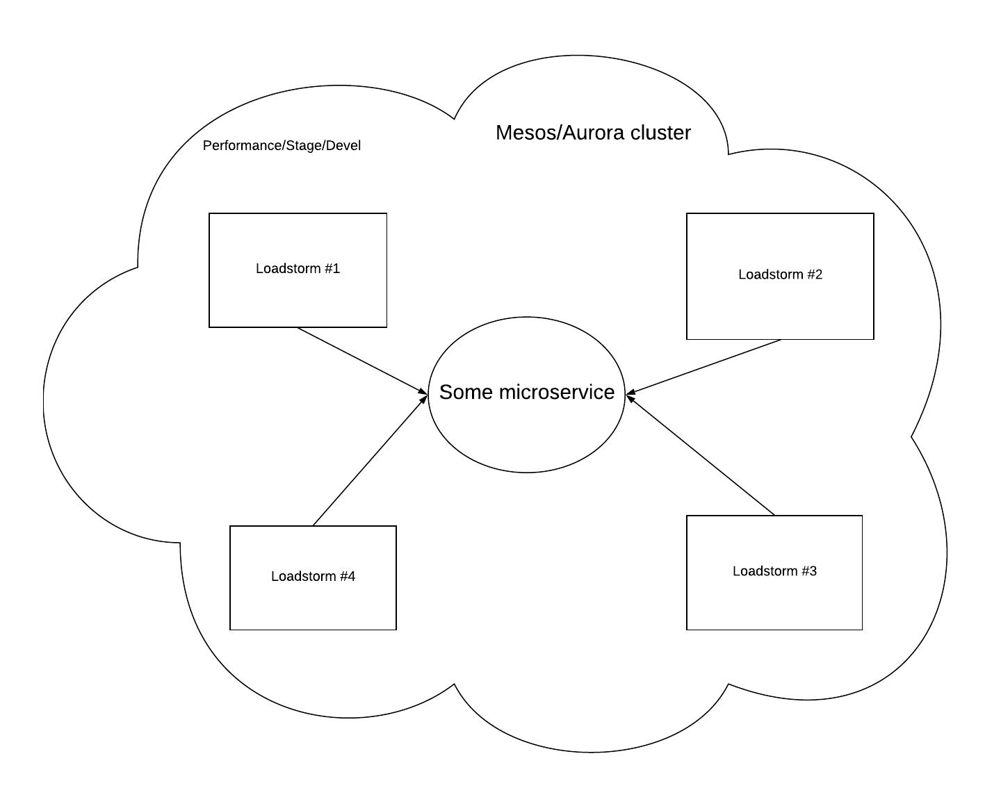
Loadstorm

Slide 12
Redline
This is an in-house tool that can stress test your service against production traffic
Help us to plan our capacity and budget
Supports HAproxy and Vestibule (in house API gateway)
Supports step by step traffic direction
Automatically stops bombing your service when “redline” achieved

Slide 13
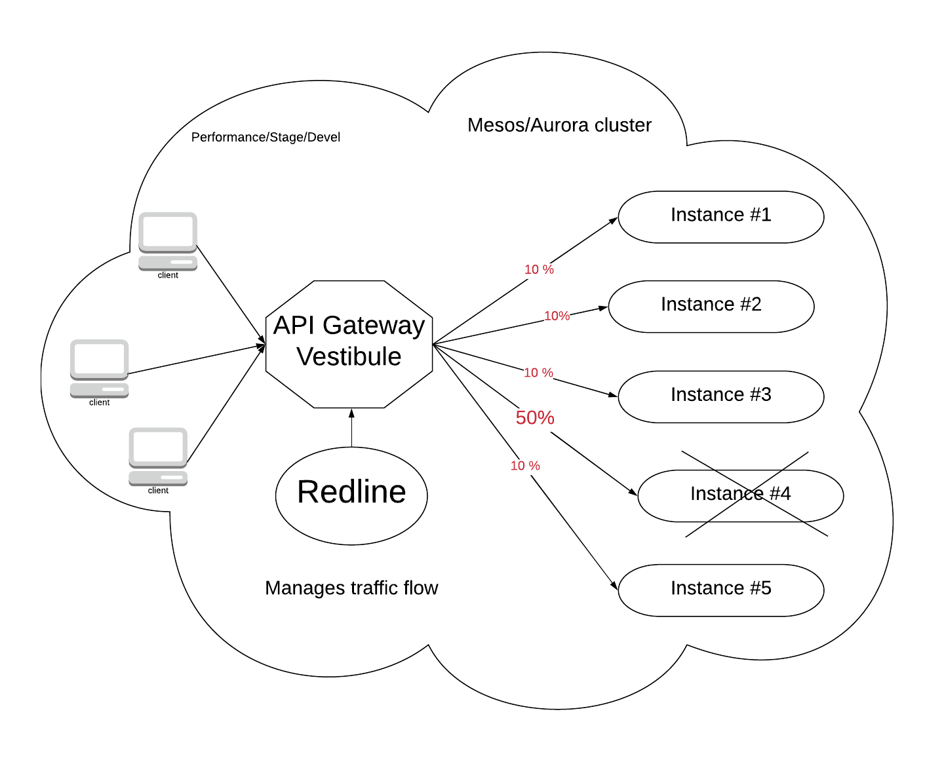
Redline

Slide 14
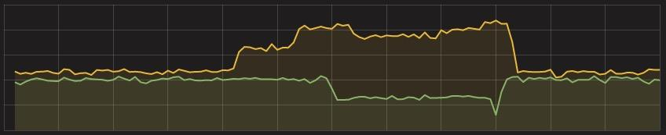
Redline
Real Time, Live Traffic shift to an isolated node
Shown here is RPS to a live service
Nearly doubled the traffic to a single node

Slide 15
Meanshift solution for anomaly detections
In-house R based solution using Mean Shift, Seasonal Trend Decomposition using Loess (STL) algorithms
Detects anomalies in time series patterns
Alerts when anomalies is detected (this is configurable)
Helps us to understand the problems that cannot be detected with alerts

Slide 16
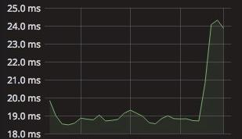
Meanshift solution for anomaly detections
Detected a change in response time of 5ms
Still within SLO of the service
Stable pattern changed which signals for an investigation

Slide 17
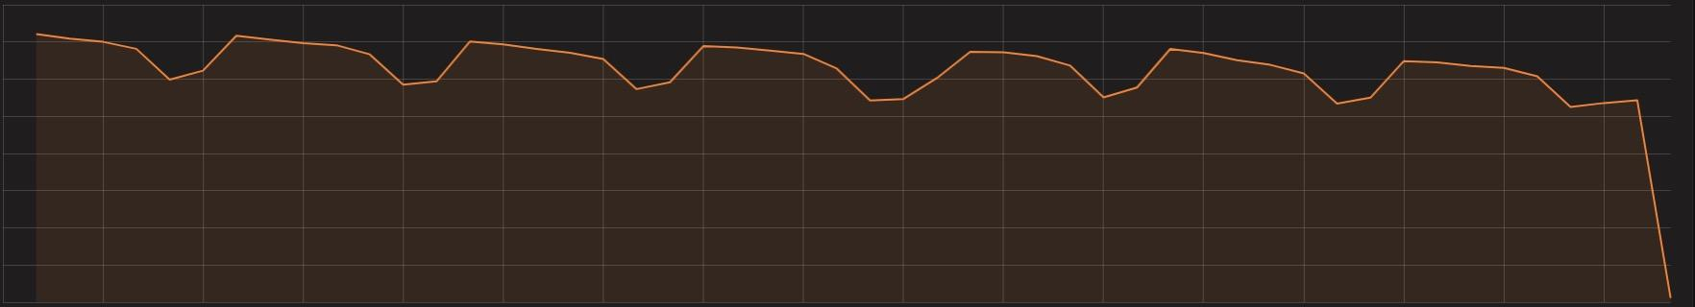
Meanshift solution for anomaly detections
Can everyone see what is wrong with this graph?

Slide 18
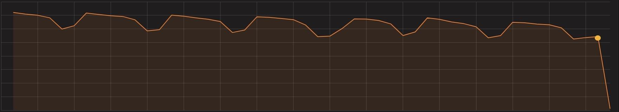
Meanshift solution for anomaly detections
Can everyone see what is wrong with this graph?
This dot is too low and triggered an alert before the crash

Slide 19
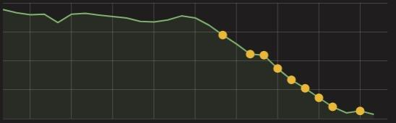
Meanshift solution for anomaly detections
Gradual changes are also caught

Slide 20
Plans for future
Make performance testing first class citizen in our company
Fully integrate performance into teams pipelines
Cultivate performance culture among Fitbit engineers
Understand our budget/capacity and save more money for the company
Notes:
Еще много предстоит сделать
Мы хотим внедрить культуру performance testing среди наших инженеров и понимание его важности для компании
Помогать инженерам интегрировать load/stress тесты в их пайпланы
Донести до всех разработчиков важность и нужность для компании того что мы делаем
Проводить воркшопы и объяснять как пользоваться нашим тулингом для решения своих задач

Slide 21
Thank You!

Slide 22
Questions ?

